Slide 1




DIGITAL LITERACY
SKILLS
ADVANCED USERS

Slide 2
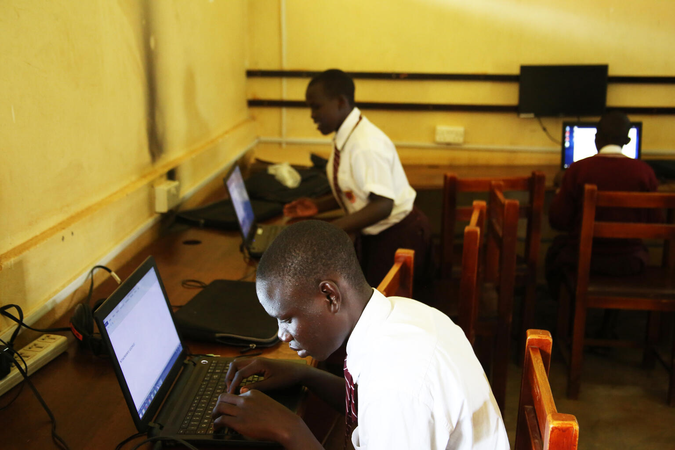
Module 6
Problem solving

Slide 3

4
Unit 4: Identifying digital competence gaps

Slide 4

The digital skills gap
Digital technologies are used in most business and industry sectors.
The demand for information and communications technology specialists is growing fast.
In the future, 9 out of 10 jobs will require digital skills.

Slide 5

Update digital skills
Invest in education
Hit subscribe
Join groups
Get on board with Google Alerts
Head to YouTube
Use hashtags

Slide 6
Skills to practise
Practise new skills
Check the vlogs and websites that you bookmarked as favourites in the previous unit.
Check for updates and practise the new skills.

Slide 7
All back covers should include
contact information of the section
producing the work.
© United Nations Children’s Fund (UNICEF) [month and year of publication]

